Slide 1
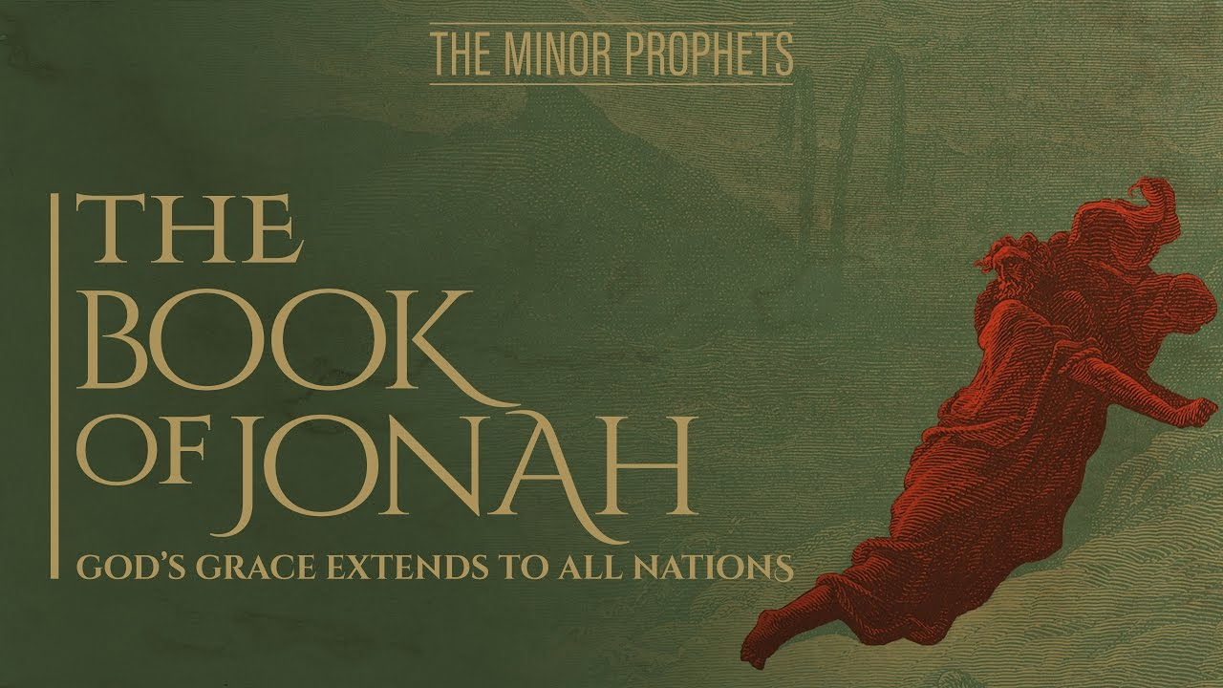

Slide 2

Introduction
Titled after principal character– “Dove”
Date: ca. 783-753 (Jeroboam II, Uzziah)
2 Kings14:25- Prophet from Gath-hepher

Slide 4
Introduction
Titled after principal character– “Dove”
Date: ca. 783-753 (Jeroboam II, Uzziah)
2 Kings14:25- Prophet from Gath-hepher
Assyria is the ruling power

Slide 6
Introduction
Titled after principal character– “Dove”
Date: ca. 783-753 (Jeroboam II, Uzziah)
2 Kings14:25- Prophet from Gath-hepher
Assyria is the ruling power
Key Passage: Jonah 4:2b
Key Message: God’s Lovingkindness
Typology/ Allegory in Jonah

Slide 7
Outline
Jonah flees his mission (1:1–2:10)
  Jonah’s Commission and Flight (1:1-3)
  The Sailors cry out to their gods (1:4-6)
  Jonah’s disobedience comes to light (1:7-10)
  Jonah takes drastic measures and God delivers (1:11-17)
  Jonah prays to God and makes a vow (2:1-10)

Slide 8
Outline
II. Jonah fulfills God’s will but is displeased (3:1–4:11)
  Jonah’s Commission and Acknowledgement (3:1-4)
  The wicked city repents and turns to God (3:5-9)
  God relents concerning the calamity according to His lovingkindess (3:10–4:2)
  Jonah pleads to have his life taken away (4:3-4)
  God appeals to Jonah (4:5-11)

Slide 9
Chapter 1
1:1-3– Jonah is called but flees
  Their wickedness has come up to God
  Gen.18:20,19:13– Sodom and Gomorrah
  Why run to Tarshish? Run from God?

Slide 11
Chapter 1
1:1-3– Jonah is called but flees
  Their wickedness has come up to God
  Gen.18:20,19:13– Sodom and Gomorrah
  Why run to Tarshish? Run from God?
  Trying to get away as far as possible
  Psalm 139:7-12; Heb. 4:13

Slide 13
Chapter 1
1:4-6– Sailors cry out to their gods
  God tries to bring Jonah to his senses
  LORD(YHWH) vs. Baal controlling weather
  Sailors are fearful and cry out to gods (Elohim)
  Sailors desperately pray; Jonah sleeps
  Pleading with Jonah to call on his god

Slide 14
Chapter 1
1:7-10– Jonah’s disobedience is known
  Casting lots– Josh.7:14; Prov.16:33
  Jonah is found out and is questioned
  Jonah’s response causes the men to be even more fear
  Sailors are astounded with Jonah
  Seem to have more sense than he does

Slide 15
Chapter 1
1:11-17–Jonah’s idea and God’s deliverance
  Storm keeps intensifying
  Jonah wants to be thrown into the sea
  Gentiles have more concern for Jonah than he has had for them
  Transition from Elohim to YHWH
  Jonah is thrown into the sea and God delivers him

Slide 17
Chapter 2
2:1-10–Jonah prays to God from the fish
  Seeks God in his distress
  Jonah wanted to run far away; God delivers
  Depths of Sheol (v.2)
  Gen.37:35; Psa.18:5; Psa.86:13
  Jonah’s recognition of God’s actions
  Impossible situation; God delivers even when it seems impossible

Slide 18
Chapter 2
2:1-10–Jonah prays to God from the fish
  Expelled from God’s presence (v.4)
  Gen.3:24; Jer.7:15; Isa.59:1-2
  Nowhere to go but God!
  Jonah retells his horrors to emphasize God’s deliverance
  No escape seems possible; God shows otherwise

Slide 20
Chapter 2
2:1-10–Jonah prays to God from the fish
  Jonah remembered God (v.7); God listens
  God contrasted with vain idols
  Salvation only in God; Jonah makes a vow
  Chapter began with death; ends with life
  Pictures of the Messiah in chapter 2; The Resurrection is typified

Slide 21
Outline
II. Jonah fulfills God’s will but is displeased (3:1–4:11)
  Jonah’s Commission and Acknowledgement (3:1-4)
  The wicked city repents and turns to God (3:5-9)
  God relents concerning the calamity according to His lovingkindess (3:10–4:2)
  Jonah pleads to have his life taken away (4:3-4)
  God appeals to Jonah (4:5-11)

Slide 22
Chapter 3
3:1-4– Jonah is called again and goes
  Jonah acknowledges God and does His will
  Exceedingly great city; 3 days journey

Slide 24
Chapter 3
3:1-4– Jonah is called again and goes
  Jonah acknowledges God and does His will
  Exceedingly great city; 3 days journey
  Proclamation of great fear (1:10)
  40 days tied to Gen. 7? Limited time?
  Don’t repent; experience judgment
  Overthrow (Gen.19:21,25)

Slide 26
Chapter 3
3:5-9–The Assyrians repent of their sins
  The people believe in God; by faith
  Followed by works of repentance (vv.5-9)
  Sackcloth, fasting, ashes (Repentance, sin)
  All are involved in repenting; even King
  Who knows? (Joel 2:14; Amos 5:15)
  Where there is life, there is hope!

Slide 27
Chapter 3
3:10-4:2– God relents concerning calamity
  God observes repentance of the people and decides not to destroy them
  Is Jonah a false prophet? (Deut.18:22-23)
  What about Jer.18:7-11?

Slide 28
Chapter 4
4:1-2– God relents concerning calamity
  Jonah is greatly displeased
  This is why he ran in the beginning (1:3)
  Jonah wanted them to perish
  God’s lovingkindness; one of the most repeated phrases in OT
  God wants all to repent
  Jonah’s faith

Slide 29
Chapter 4
4:3-4– Jonah pleads with God to die
  Jonah wants to die because of Nineveh’s deliverance
  What about Elijah, Job, Jeremiah?
  God questions Jonah’s anger
  Gen.4:6-7 Example of Cain

Slide 30
Chapter 4
4:5-11– God appeals to Jonah
  God seeks to turn Jonah while he is still waiting for the city to be destroyed
  “God appointed”…phrase repeated several times throughout chapter
  Jonah wants some comfort/deliverance
  Jonah shows compassion for plant he didn’t work for, shouldn’t God show compassion for people?

