Slide 1
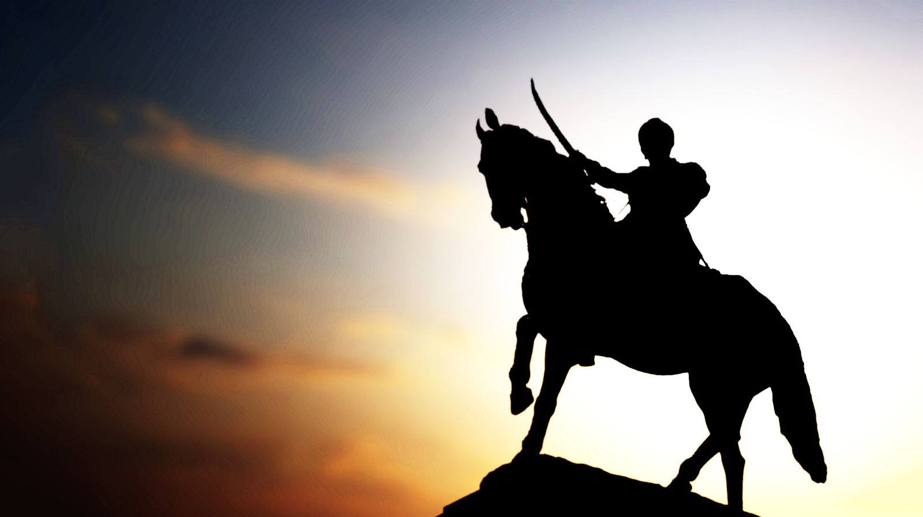
God Always Wins!
Pictures of Victory in Revelation

Slide 2

Victory in Revelation
Victory at Har-Magedon
    Brutal battles
    Battle never happens
2. Victory for saints; beast worshippers killed
    Sea beast worshipped
    Saints are saved
    Enemies are cruelly defeated
3. Jesus’ victory over death
    Most important victory
    Worthy lamb alive forever

Slide 3
The End Results
God is revered and glorified
    Praise to the Highest
    All will bow
    He always wins!
2. Jesus died so all could live
    Salvation possible for all
    God always wins!
3. Faithful saved; Enemies destroyed
    Serve God or die
    God always wins!

