Slide 1
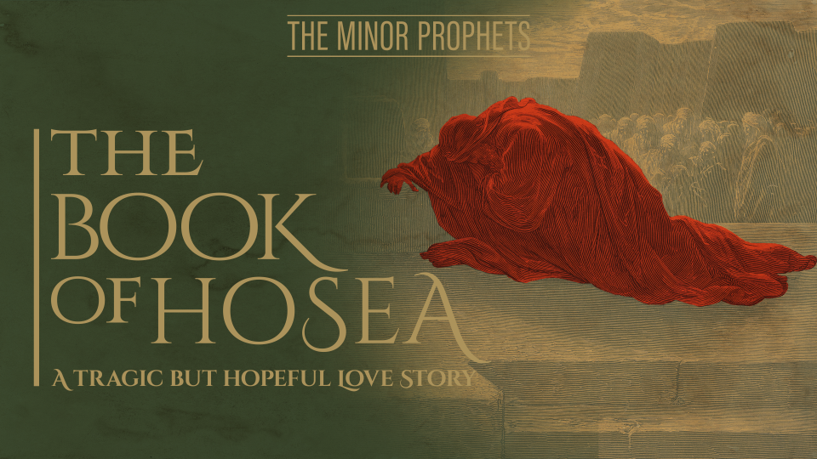

Slide 2

Introduction
Named after the prophet– Salvation or help
Main character: God
Date: ca. 755-710 BC (Uzziah, Jotham, Ahaz, Hezekiah, Jeroboam II)
Hosea son of Beeri probably from Israel
Political Climate: Chaos, Anarchy, War
Key Passage: Hosea 14:1-2
Key Message: Israel unfaithful, God faithful

Slide 3
Outline
Hosea’s Family(1:1–3:5)
Faithless nation and Faithful God (4:1–14:9)

Slide 4
Chapter 1
1:1-2 – Title and Hosea’s Marriage
  God’s message to Hosea
  Hosea son of Beeri
  4 Kings of Judah; 1 from Israel
  Beginning of Hosea’s ministry
  Go and take yourself a wife
  A harlot? Nature of the word harlotry

Slide 5
Chapter 1
1:1-2 – Title and Hosea’s Marriage
  Promiscuous or profession?
  Various interpretations
  Root word for harlotry refers to idolatry
  View 1: Gomer not a literal harlot when married to Hosea
  View 2: Gomer a harlot when wed to Hosea

Slide 6
Chapter 1
1:1-2 – Title and Hosea’s Marriage
  Difficult in knowing is she was harlot before or after marriage
  Parallels in Israel’s history
  Israel faithful first; falls later
  Israel serving idols as God took them
  Have children of harlotry

Slide 7
Chapter 1
1:1-2 – Title and Hosea’s Marriage
  Inheriting promiscuity?
  Out of adultery?
  Part of idolatrous nation?
  Flagrant harlotry of Israel (Ezek.16, 23)
  Hosea’s marriage reflects Israel’s relationship with God
  Hosea not only prophet living out message

Slide 8
Chapter 1
1:3-5 – Jezreel
  Hosea follows command
  Gomer “bore him a son”
  Gomer faithful at first?
  Jezreel (God scatters or God sows)
  Fertility cult; Baal worship
  God gives life not Baal

Slide 9
Chapter 1
1:3-5 – Jezreel
  City of Omride dynasty’s death; bloodshed
  Jehu’s house punished
  Household became corrupt
  Zechariah murdered by Shallum
  Kingdom coming to an end
  Bow destroyed; valley of Jezreel

Slide 10
Chapter 1
1:6-7 – Lo Ruhamah
  Is she Hosea’s child?
  No compassion on Israel; judgment time
  Judah shown compassion
  Assyria the enemy
  Sennacherib’s invasion of Jerusalem
  185,000 killed

Slide 11
Chapter 1
1:8-9 – Lo Ammi
  Significance of weaning
  Not my people
  Not Hosea’s child? Gomer divorced?
  God putting away Israel

Slide 12
Chapter 1
1:10-2:1 – Future Blessings
  Future Messianic Kingdom
  Patriarchal promises
  Sons of the living God; Gentiles
  Judah, Israel; New covenant; One leader
  Jezreel from negative to positive
  Ammi; Ruhamah

Slide 14
Chapter 2
2:2-13 – Israel is Unfaithful
  Court case; contend with mother
  God divorcing Israel
  Harlotries(idolatry); face, breasts
  Naked; day of birth; desert land; thirst
  Israel will be nothing w/out God
  No compassion on children

Slide 15
Chapter 2
2:2-13 – Israel is Unfaithful
  Mother played harlot; chased lovers
  Reliance on physical amenities
  Road blocks; seek and not find
  Return to my husband
  They do not know; blessings from God
  Blessings used in Baal worship

Slide 16
Chapter 2
2:2-13 – Israel is Unfaithful
  Agricultural devastation; sustenance taken
  Strip naked; shame and destitute
  No one can save her
  Feasts and celebrations end; vines, figs
  Punishment related to Baal worship
  Focus on Baal; forgot God

