Slide 1
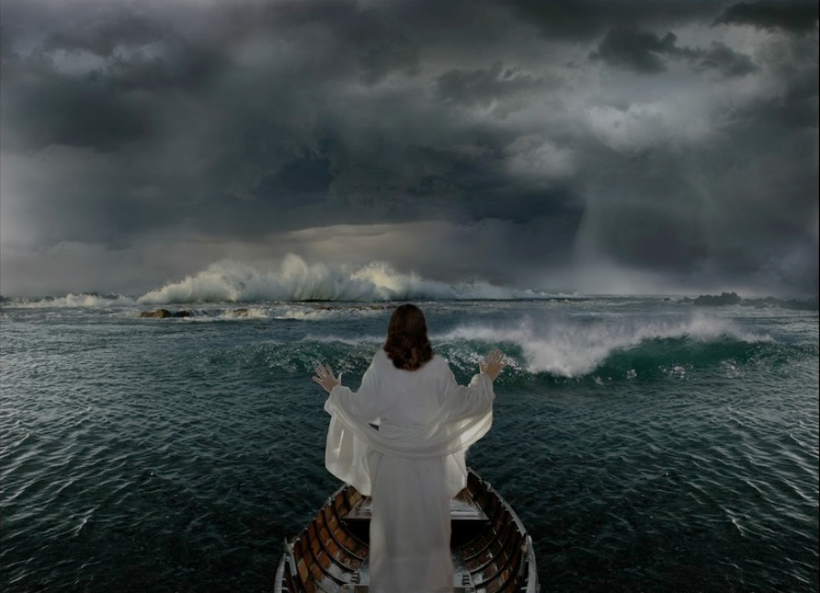
A Tale of Two Storms

Slide 2
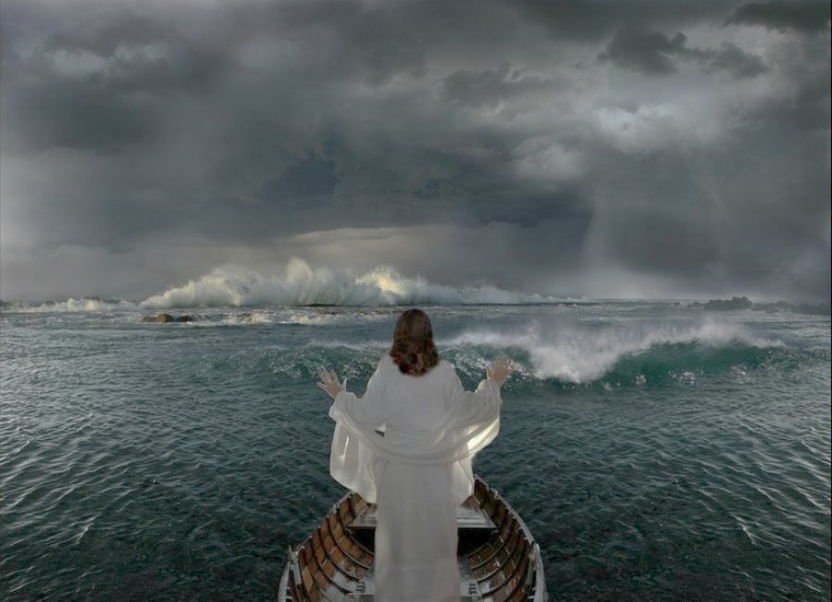
On The Sea
In Your Life
  The fierce storm
  The desperate cry
  The powerful rebuke
  The lack of faith
  The gravity of sin
  The desperate cry
  The powerful rebuke
  Do you believe

Slide 3
A Tale of Two Storms

