Slide 1
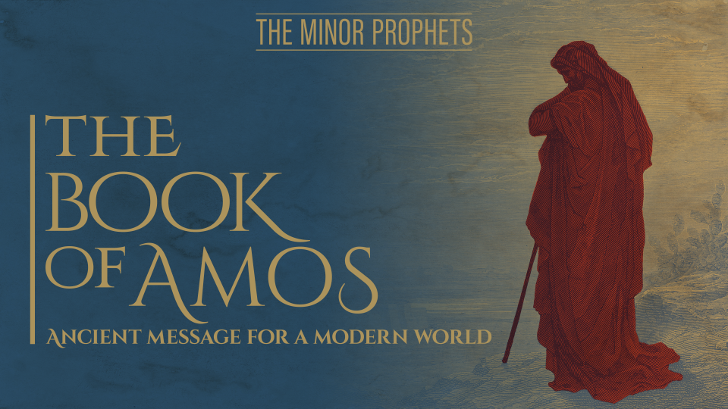

Slide 2

Introduction
Named after the prophet– “Burden-bearer”
Date: ca. 760-750 BC (Jeroboam II, Uzziah)
Amos 1:1– Prophet from Tekoa (Judah)

Slide 4
Introduction
Named after the prophet– “Burden-bearer”
Date: ca. 760-750 BC (Jeroboam II, Uzziah)
Amos 1:1– Prophet from Tekoa (Judah)
Falls under Assyrian timeline
Political Climate? Aram primary oppressor
Key Passage: Amos 5:14-15
Key Message: Seek God, Hate Evil, Do Good…

Slide 5
Outline
Judgment on the Nations (1:1–2:16)
Oracles of Judgement Against Israel (3:1–6:14)
Visions of Divine Retribution (7:1–9:10)
Restoration (9:11-15)

Slide 6
Chapter 1
1:1-2– The Lion Roars
  Sheepherder from Tekoa
  Message received through visions (Num.12:1-7)
  Message concerning Israel
  Jeroboam II– Israel; Uzziah– Judah
  The Earthquake? Zech. 14:5

Slide 7
Chapter 1
1:1-2– The Lion Roars
  LORD roars– Lion of Judah (Gen.49:8-9)
  Picture of terror and fear; warning
  What or where is Zion?
  God’s dwelling place

Slide 9
Chapter 1
1:1-2– The Lion Roars
  LORD roars– Lion of Judah (Gen.49:8-9)
  Picture of terror and fear; warning
  What or where is Zion?
  God’s dwelling place
  Ground mourns; Carmel dries up– Drought
  The Earthquake? Zech. 14:5

Slide 10
Chapter 1
1:3-5– Judgment on Damascus
  Repetitive Pattern:
    Thus says the LORD
    For 3 transgressions and for 4
    I will not revoke its punishment
    Because…(description of sin)
    I will send fire

Slide 11
Chapter 1
1:3-5– Judgment on Damascus
  8 nations addressed in 1:3–2:16
    6 “Heathen Nations”
    2 “Covenant Nations”
  Significance of crisscross pattern?

Slide 14
Chapter 1
1:3-5– Judgment on Damascus
  8 nations addressed in 1:3–2:16
    6 “Heathen Nations”
    2 “Covenant Nations”
  Significance of crisscross pattern?
  “For 3 transgressions and for 4”
  Enough evidence for conviction (sin upon sin)

Slide 16
Chapter 1
1:3-5– Judgment on Damascus
  A prominent city in Aram

Slide 18
Chapter 1
1:3-5– Judgment on Damascus
  A prominent city in Aram
  “Threshed Gilead; sharp iron”
  Gilead east of the Jordan
  Reference to cruelty and brutality
  Fire upon Hazael; citadels of Ben-Hadad
  Safe places aren’t safe from God

Slide 19
Chapter 1
1:3-5– Judgment on Damascus
  God’s judgment will penetrate defenses
  People will be slaughtered (cut off)
  “Aven”– Wickedness
  “Beth-Eden”– House of Pleasure
  Where is Kir?
  Aram go back to captivity

Slide 20
Chapter 1
1:6-8– Judgment on Gaza

Slide 22
Chapter 1
1:6-8– Judgment on Gaza
  South Philistia; prominent port city
  Philistines common enemies of Israelites
  Punished for deliverance of a nation to Edom
  Fire upon Gaza and its citadels
  People slaughtered; no one shall escape

Slide 24
Chapter 1
1:9-10– Judgment on Tyre
  Capital of Phoenicia; Major port city

Slide 26
Chapter 1
1:9-10– Judgment on Tyre
  Capital of Phoenicia; Major port city
  Exportation included people sold into slavery
  Punished; Delivered people to Edom (v.6)
  Treaty with David and Solomon broken
  Fire upon walls and citadels of Tyre

Slide 27
Chapter 1
1:11-12– Judgment on Edom

Slide 30
Chapter 1
1:11-12– Judgment on Edom
  Edom– Nation from Esau; enemies of Israel (Gen. 25:19-34)
  Saul, David and Amaziah fought against them
  Hatred; raiding cities, taking captives as slaves
  Punished; stifled compassion, constant pursuit

Slide 31
Chapter 1
1:11-12– Judgment on Edom
  Fire upon Teman, Bozran; extreme north and south cities

Slide 33
Chapter 1
1:13-15– Judgment on Ammon

Slide 35
Chapter 1
1:13-15– Judgment on Ammon
  Ammon– Nation from Ben-Ammi (Gen. 19:37-38)
  Continuously seeking to expand borders
  Fierce people; idolatrous
  Known for their cruel atrocities
  Related to Israel but refused to help

Slide 36
Chapter 1
1:13-15– Judgment on Ammon
  Punished; ripped open pregnant women
  Fire upon walls and citadels of Rabbah
  War cries; storm in day of tempest
  Rulers will be exiled

Slide 37
Chapter 2
2:1-3– Judgment on Moab

Slide 39
Chapter 2
2:1-3– Judgment on Moab
  Nation from Moab (Gen.19:37-38)
  Enemies of Israel (Deut.23:3-4)
  Ruth prominent Moabite (Matt.1:5-6)
  Burn the bones of King of Edom
  Fire upon Moab; Kerioth
  Cut off judge, princes

Slide 40
Chapter 2
2:4-5– Judgment on Judah

Slide 42
Chapter 2
2:4-5– Judgment on Judah
  Covenant nation (2 Kings 17:2)
  Rejection of God’s law (2 Kings 17:19)
  Chosen people responsible to know His laws (2 Kings 22:11-20)
  “Their lies…” Idolatry
  Fire upon Judah; Jerusalem

Slide 43
Chapter 2
2:6-16– Judgment on Israel

Slide 45
Chapter 2
2:6-16– Judgment on Israel
  Their turn has come
  Kings did evil; known for its idolatry
  “Sell the righteous…”
  “The needy for…”
  “Pant head of helpless”
  “Turn aside humble”

Slide 46
Chapter 2
2:6-16– Judgment on Israel
  “A man and his father”
  Cloak as pledge (Ex. 25:26-27); Wine
  God speaks about all He has done for them (vv.9-11)
  Emphatic use of pronoun “I”
  Destruction of Amorites (Josh. 10-12)

Slide 47
Chapter 2
2:6-16– Judgment on Israel
  Out of Egypt (Ex. 20:2; Deut. 5:6)
  Prophets; Nazarites (Deut. 18:18; Num. 6:1-21)
  Israel rejected God
  Two meanings? (2:13)
  Judgment (vv. 14-16)

