Slide 1
The Writing on The Wall:
WHEN WE FAIL TO LEARN…

Slide 2
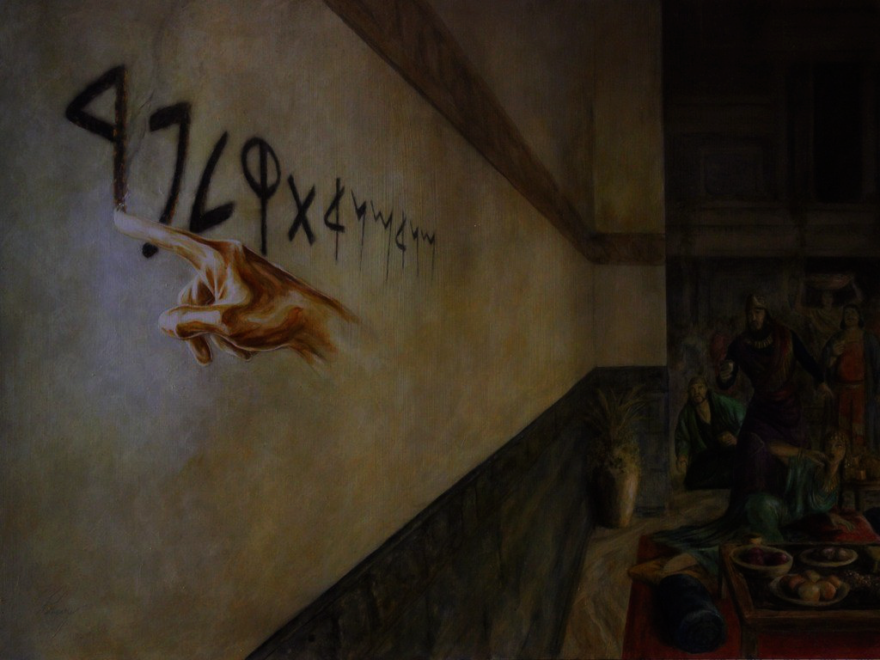
Setting the Scene
Belshazzar’s grand celebration
Blasphemy, Idolatry Holy Vessels
Disembodied hand writing on wall
Wise men baffled
Daniel is summoned
Striking rebuke then interpretation

Slide 3
The Writing on The Wall
Awareness of God with Daniel
Kingdom numbered and ended
Babylonians crumble
Emphasis on fear and finality
MENE

Slide 4
The Writing on The Wall
Weighed and found deficient
Missing quality/ingredient
Failure to recognize, glorify God
Failure to be humble
TEKEL

Slide 5
The Writing on The Wall
Kingdom divided and given over
Temporary reign, tragic end
God rules in affairs of men
Belshazzar’s death; did not learn
UPHARSIN

Slide 6
When We Fail To Learn
Learn from the errors of others
Taking advantage of mistakes
God will number our days
Christians/Non Christians
MENE

Slide 7
When We Fail To Learn
Stepping up to the scale
Consuming vitamins, nutrients
Building spiritual muscles
Bearing fruit
TEKEL

Slide 8
When We Fail To Learn
Unworthy; talent given to others
God is in control
Be humble and give Him glory
God has written on the wall
UPHARSIN

