Slide 1
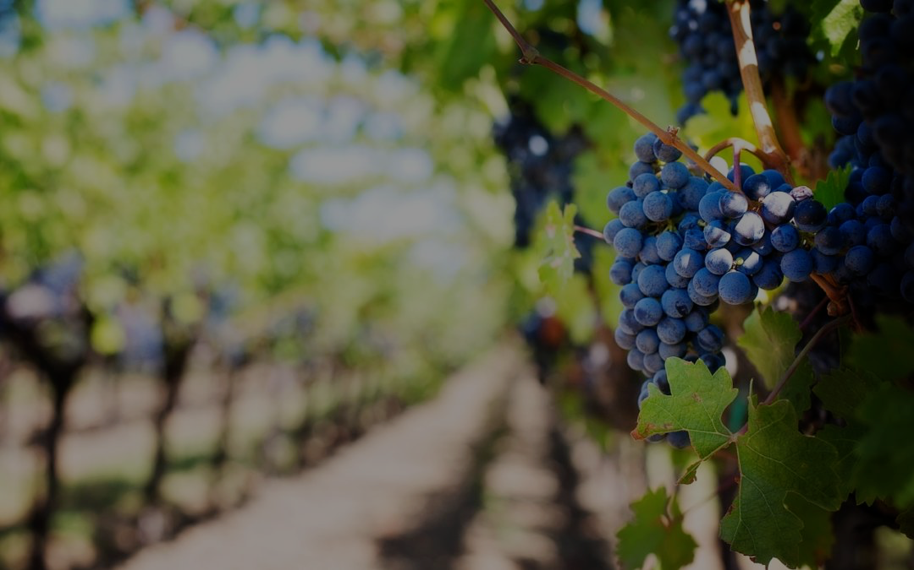
The True Vine and Its Branches

Slide 2
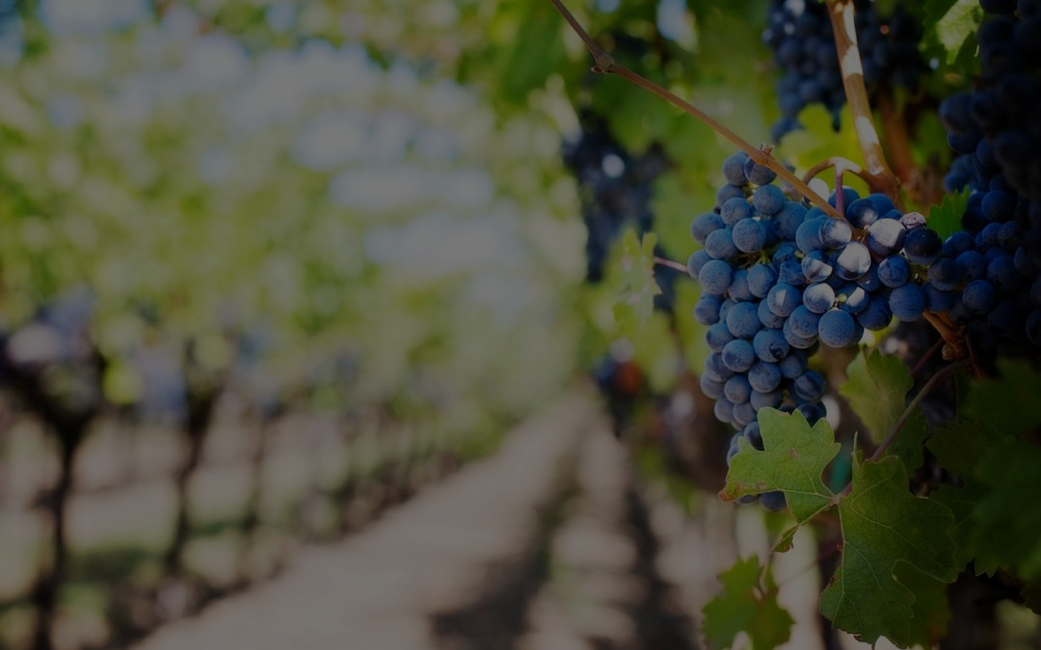
OT Significance of Vine
Peace and prosperity
    Golden age
    Covenant blessings
Choice people planted by God
    Israel as the vine
    Negative references

Slide 3
True Vine and Its Branches
Jesus is true and faithful
Jesus the source of all life
Branches called to bear fruit
Disciples must abide in Vine
Fruitful branches pruned

