Slide 1
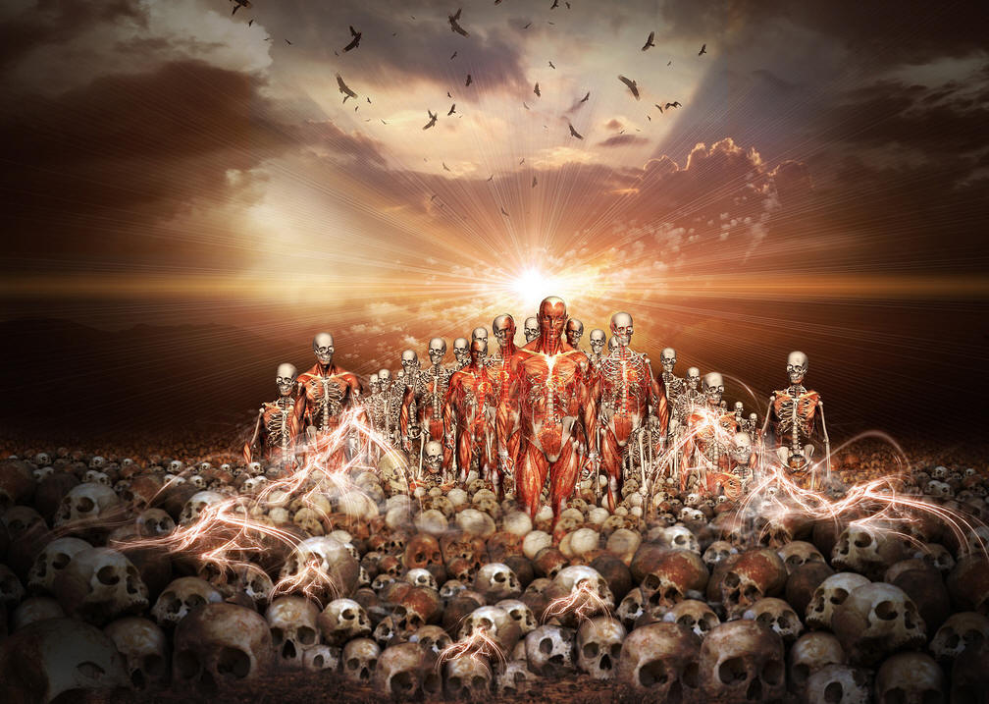
The Valley of Dry Bones

Slide 2
A Great Resurrection
Raised to Life- A New Creation: Ezek. 37:3-10
      Can these bones live?
      What God can do
      Army raised to life
The Chilling Scene: Ezek. 37:1-2
    Catastrophe and disaster
    Purposeful lack of burial
    Bones there for an extended time
A Renewed Hope: Ezek. 37:11-14
    Bones all of Israel separated
    Sin and the covenant curses
    Graves would be opened
    Messianic Age

Slide 3
From Disaster To Blessing:
Sin leads to valley of death and despair
Jesus died to rescue us from that valley
If we come to Him, we will have new life

