Slide 1
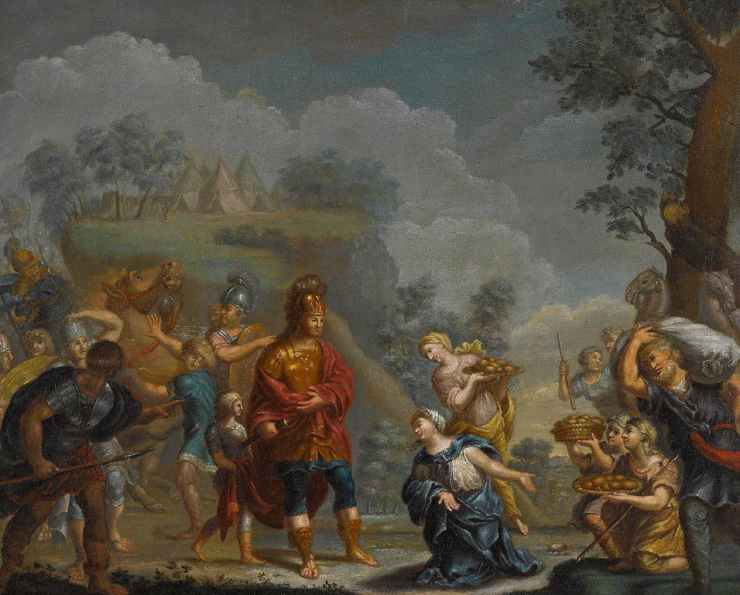
Abigail: A Type of Christ

Slide 2
David and Nabal
Sheep shearing in Judea (spring time; 1 Sam. 25:2, 4)
Nabal (foolish) shearing sheep (1 Sam. 25:2, 5-7)
David’s men working and seeking pay (1 Sam. 25:8)
Nabal refuses to comply (1 Sam. 25:9-11)
David’s men return (1 Sam. 25:12-13)
Nabal’s young men updates Abigail (1 Sam. 25:14-17)
Nabal’s foolishness; Abigail’s intelligence

Slide 3
Abigail’s Actions
The willing intercessor: vv. 18-22
  Character and courage
  Seeks to remedy problem Nabal created
  Seeks to do good to her husband
  David and his men seeking blood

Slide 4
Abigail’s Actions
Took blame on herself: vv. 23-25
  Prostrates, respect, honor, humility
  Takes blame for what Nabal did
  Appeals to David in wisdom and humility
  If she knew, she would have done better

Slide 5
Abigail’s Actions
Defuses volatile situation: vv. 26-34
  David’s attentive; skillfully and wisely defuses
  Encourages David in relation to her knowledge
  Asks David to forgive her sin
  David acknowledges Abigail; prevents bloodshed

Slide 6
Jesus’ Actions
The Willing Intercessor: 1 Tim. 2:5-6
  When we choose to sin, we become Nabal
  Fail to submit to God, death certificate signed
  Jesus willingly stepped in on our behalf
  God’s wrath demands sin be taken care of

Slide 7
Jesus’ Actions
Took man’s sin on Himself: 2 Cor. 5:21
  Jesus took blame for what we did
  God satisfied to bruise Him in our place
  Sought our good even though undeserving
  Comes to fix situation man created

Slide 8
Jesus’ Actions
Defuses volatile situation: Col. 1:13
  Jesus satisfied God’s wrath; bridge completed
  “Father forgive them, know not what they do”
  “Child death is close, I died to save you”
  Repent and be baptized

