Slide 1
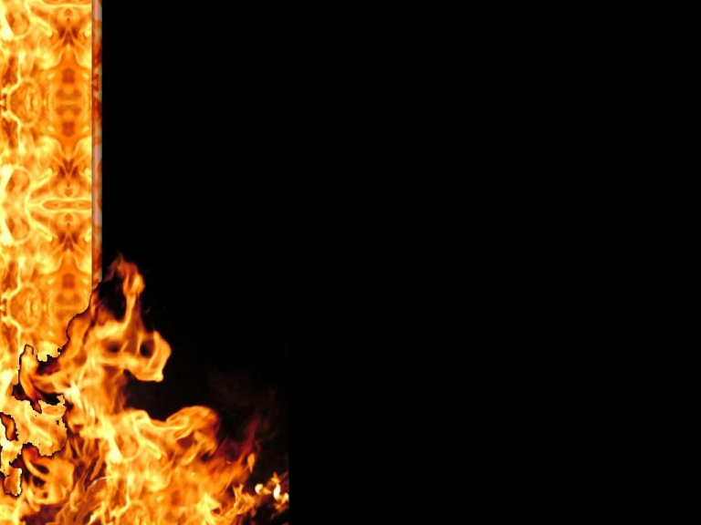
Fan the Flame
The Devil wants You to Fail
Thrives on weakness, pain etc.
Pretends to seek our interest
Cover up seeking to destroy us
Like a lion looking for prey
Functions through lies and deceit
Seeks to extinguish fire

Slide 2
Maintain Discipline; Seek God
Fallen to sin and weaknesses
Flame diminished to pilot light
Run from Satan to God
Put distance between you and sin
Jesus the real lion fights for us
Put on the armor; pray, study, apply

Slide 3
Lean on your Spiritual Family
Family provides love, care, help
Bear one another’s burdens
Family depends on everyone
Each one must do their part
Unified and strengthened
Flame grows, harder to put out

Slide 4
Do You Want to See God?
Fan the flame
Resist the devil; say no!
Run to God; put on the armor
Reach out to your family

