Slide 2
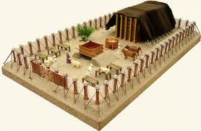
THE TABERNACLE

Slide 3
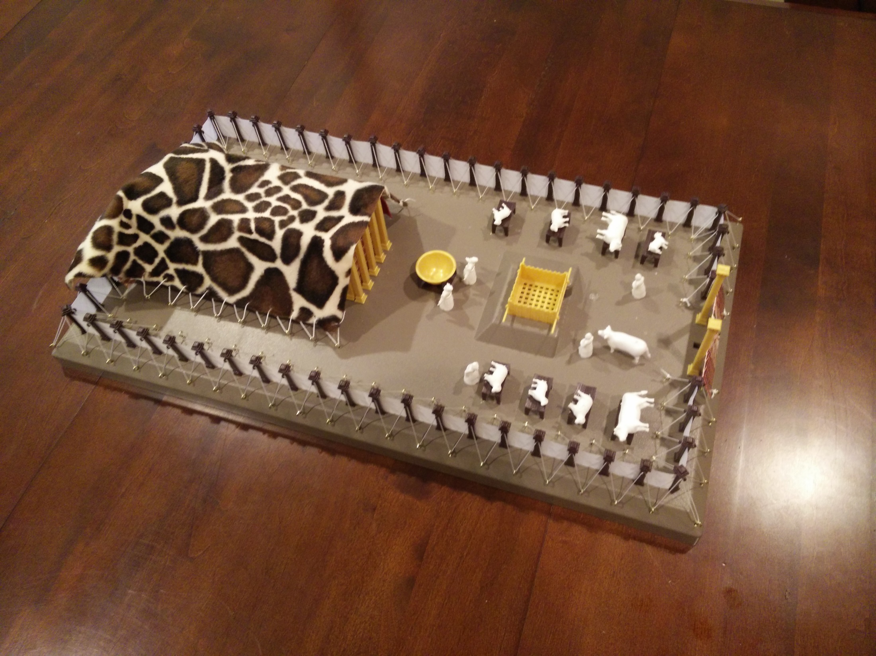
THE TABERNACLE

Slide 4
VEIL
table
Bronze
altar
Ark
Laver

Slide 5
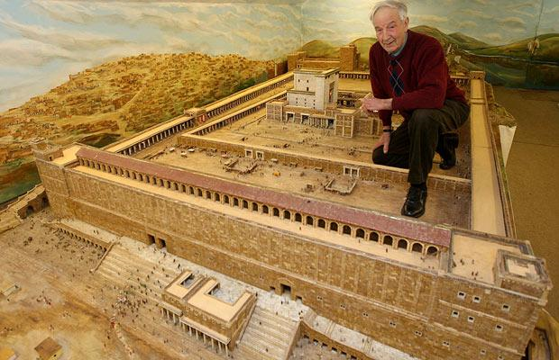
http://www.telegraph.co.uk/news/picturegalleries/howaboutthat/4837528/A-model-of-biblical-proportions-man-spends-30-years-creating-a-model-of-Herods-Temple.html

Slide 6
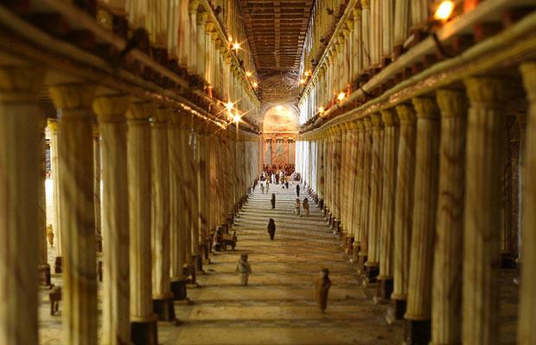

Slide 7
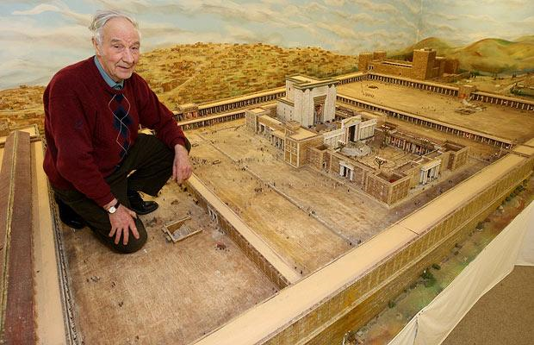
COURT OF GENTILES

Slide 8
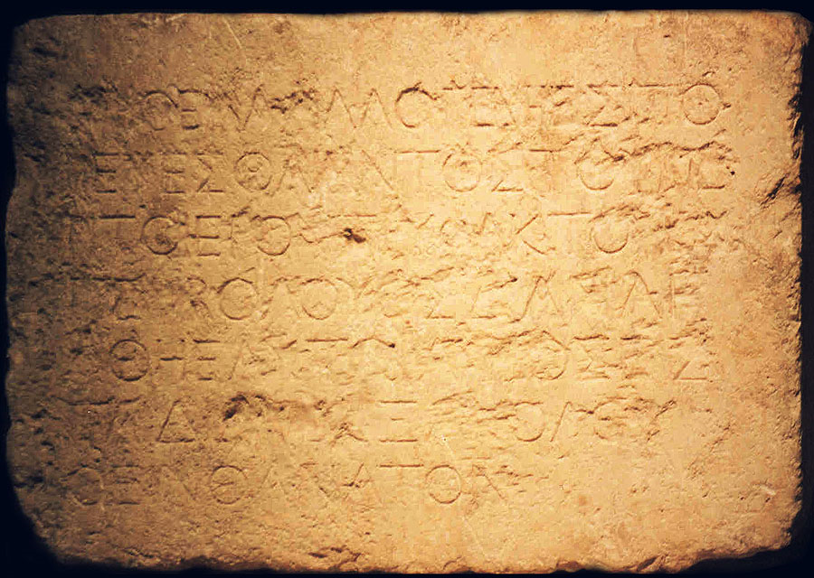
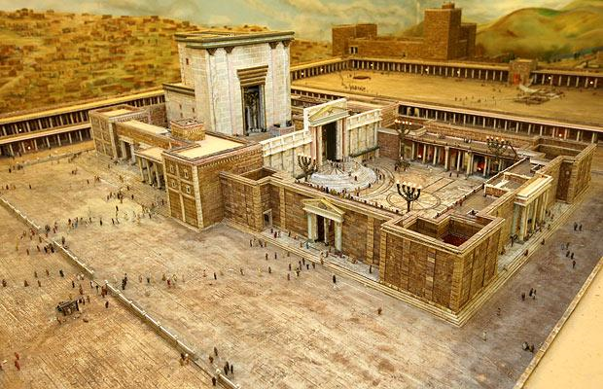
Ephesians 2:14-16
But now in Christ Jesus you who once were far off have been brought near by the blood of Christ. For he himself is our peace, who has made us both one and has broken down in his flesh the dividing wall of hostility by abolishing the law of commandments expressed in ordinances, that he might create in himself one new man in place of the two, so making peace, and might reconcile us both to God in one body through the cross…
COURT OF GENTILES

Slide 10
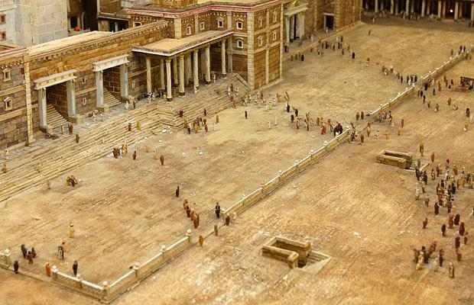
COURT OF GENTILES

Slide 11
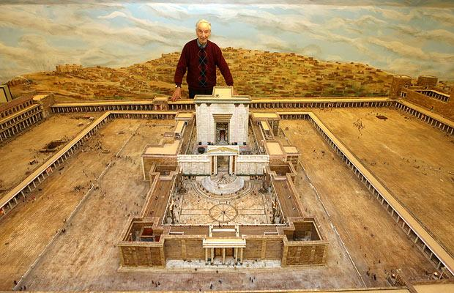
Acts 3:1-2
Now Peter and John were going up to the temple at the hour of prayer, the ninth hour. And a man lame from birth was being carried, whom they laid daily at the gate of the temple that is called the Beautiful Gate to ask alms of those entering the temple.
COURT OF GENTILES
Beautiful Gate?

Slide 12
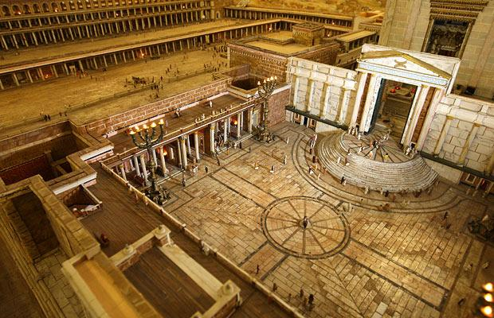

Slide 13
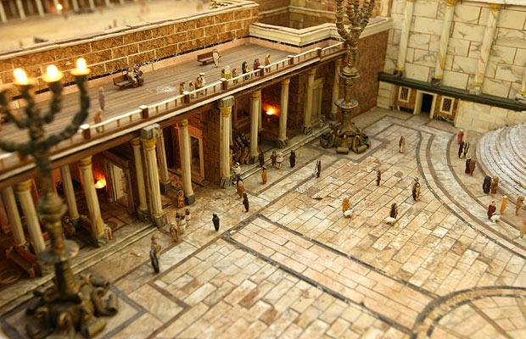

Slide 14
John 8:20
These words he spoke in the treasury, as he taught in the temple; but no one arrested him, because his hour had not yet come.
Mark 12:41-44
And he sat down opposite the treasury and watched the people putting money into the offering box. Many rich people put in large sums. And a poor widow came and put in two small copper coins, which make a penny. And he called his disciples to him and said to them, “Truly, I say to you, this poor widow has put in more than all those who are contributing to the offering box. For they all contributed out of their abundance, but she out of her poverty has put in everything she had, all she had to live on.”
COURT OF WOMEN
COURT OF GENTILES

Slide 15
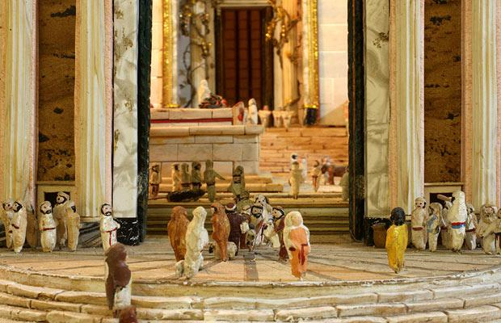

Slide 16
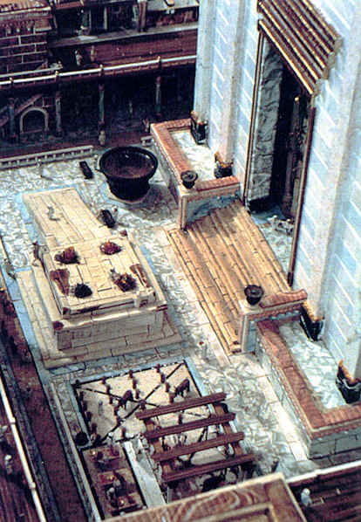
Court of Priests
Court of Israel

Slide 17
Acts 21:37-40
As Paul was about to be brought into the barracks (ASV: “castle”), he said to the tribune, “May I say something to you?” And he said, “Do you know Greek? Are you not the Egyptian, then, who recently stirred up a revolt and led the four thousand men of the Assassins out into the wilderness?” Paul replied, “I am a Jew, from Tarsus in Cilicia, a citizen of no obscure city. I beg you, permit me to speak to the people.” And when he had given him permission, Paul, standing on the steps, motioned with his hand to the people. And when there was a great hush, he addressed them in the Hebrew language…
Antonia

Slide 18
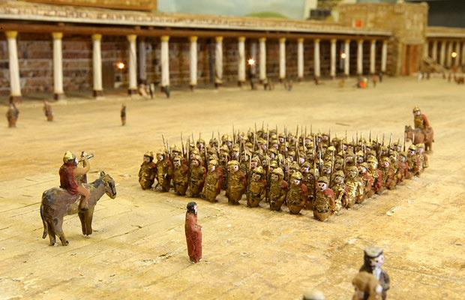

Slide 19
Antonia

Slide 20
Acts 2:46
And day by day, continuing stedfastly with one accord in the temple…
Acts 5:12
Now many signs and wonders were regularly done among the people by the hands of the apostles. And they were all together in Solomon’s Portico.
Acts 6:2
And the twelve summoned the full number of the disciples and said, "It is not right that we should give up preaching the word of God to serve tables.
165 ft.
54,450 sq. ft.
1.25 acres
10,890 people @
5 square ft./person
Solomon’s porch
330 ft.

Slide 22
Solomon’s porch

Slide 23
Mark 13:1-2
And as he came out of the temple, one of his disciples said to him, “Look, Teacher, what wonderful stones and what wonderful buildings!” And Jesus said to him, “Do you see these great buildings? There will not be left here one stone upon another that will not be thrown down.”
Matthew 12:6
I tell you, something greater than the temple is here.

Slide 25
