Slide 2
Christian Character:
The Heart of a Christian Has
Compassion & Love
Lesson 2
The Zanesville church of Christ - Lesson by Mark Householder

Slide 3
A friend in need is a friend indeed. (Love your neighbor as yourself.)
Do unto others as you’d have them do unto you.
anonymous ???

Slide 12
Follow us daily on Facebook!

Slide 14
Click & Share!

Slide 15
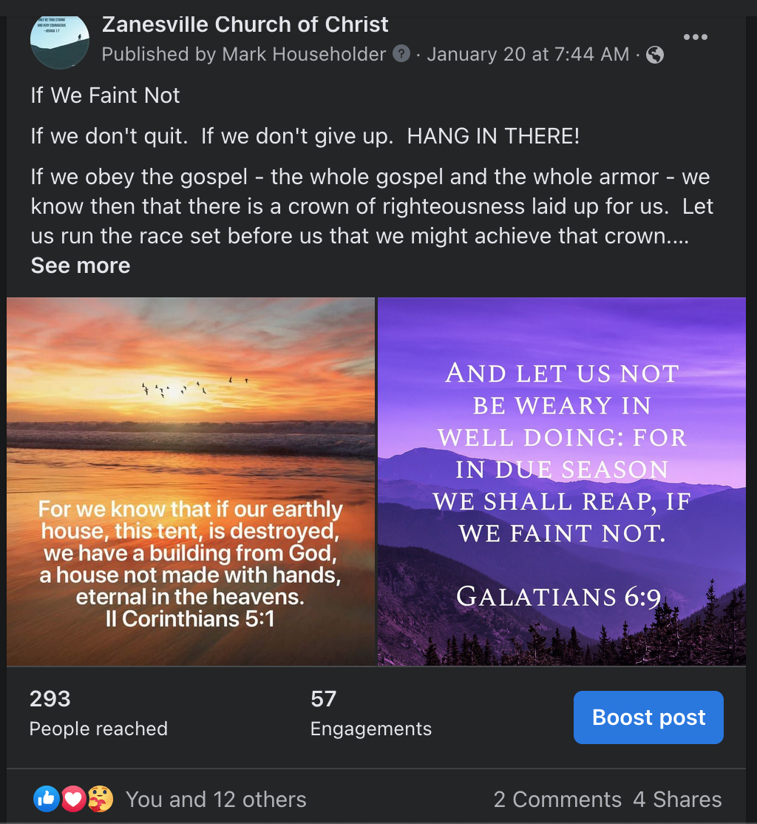

Slide 16
Click & Share!

Slide 17
This is how you reach MORE PEOPLE!

Slide 19
These are
in the Christian Heart
Think on these things.
Go and do likewise.
Let your light so shine.

Slide 20
These are
in the Christian Heart
Think on these things.
Go and do likewise.
Let your light so shine.

Slide 23
These are
in the Christian Heart
Think on these things.
Go and do likewise.
Let your light so shine.

Slide 26
These are
in the Christian Heart
Think on these things.
Go and do likewise.
Let your light so shine.

Slide 27
Think on these things.
Go and do likewise.
Let your light so shine.

Slide 28
The Christian Heart…
Fears the LORD
Hates evil
Hates pride and arrogance
Hates evil behavior
Hates perverse speech
Think on these things.
Go and do likewise.
Let your light so shine.

Slide 29
The Christian Heart…
Fears the LORD
Hates evil
Hates pride and arrogance
Hates evil behavior
Hates perverse speech
Think on these things.
Go and do likewise.
Let your light so shine.
The Christian Heart…
Hates evil
Clings to what is good

Slide 30
“For over a thousand years Roman conquerors returning from the wars enjoyed the honor of triumph, a tumultuous parade. In the procession came trumpeteers, musicians and strange animals from conquered territories, together with carts laden with treasure and captured armaments.

Slide 31
The conquerors rode in a triumphal chariot, the dazed prisoners walking in chains before him. Sometimes his children robed in white stood with him in the chariot or rode the trace horses.

Slide 32
The conquerors rode in a triumphal chariot, the dazed prisoners walking in chains before him. Sometimes his children robed in white stood with him in the chariot or rode the trace horses.

Slide 33
A slave stood behind the conqueror holding a golden crown and whispering in his ear a warning:
that all glory

Slide 34
A slave stood behind the conqueror holding a golden crown and whispering in his ear a warning:
that all glory
is

Slide 35
“fleeting.”

Slide 37
The Christian Heart…
Fears the LORD
Hates evil
Hates pride and arrogance
Hates evil behavior
Hates perverse speech
Think on these things.
Go and do likewise.
Let your light so shine.
The Christian Heart…
Hates evil
Clings to what is good
The Christian Heart…
Realizes
This life and world
are fleeting!

Slide 38
Think on these things.
Go and do likewise.
Let your light so shine.
The Christian Heart…
Hates evil
Clings to what is good
The Christian Heart…
Realizes
This life and world
are fleeting!

Slide 39
Think on these things.
Go and do likewise.
Let your light so shine.
The Christian Heart…
Realizes
This life and world
are fleeting!

Slide 40
The Christian Heart…
Realizes
This life and world
are fleeting!

Slide 41
Realizes
This life and world
are fleeting!

Slide 42
This life and world
are fleeting!

Slide 43
are fleeting!

Slide 44
fleeting!

Slide 47
What will your answer be?

Slide 49
For as many of you as were baptized into Christ have put on Christ.
There is neither Jew nor Greek, there is neither slave nor free, there is neither male nor female; for you are all one in Christ Jesus. And if you are Christ’s, then you are Abraham’s seed, and heirs according to the promise.

Slide 51
Therefore,
baptism into Christ
is
the OTHER
GREAT EQUALIZER!
It, too, is a death…

Slide 53
30 So Philip ran to him, and heard him reading the prophet Isaiah, and said, “Do you understand what you are reading?”
31 And he said, “How can I, unless someone guides me?” And he asked Philip to come up and sit with him. 32 The place in the Scripture which he read was this:
“He was led as a sheep to the slaughter; And as a lamb before its shearer is silent, So He opened not His mouth. 33 In His humiliation His justice was taken away, And who will declare His generation? For His life is taken from the earth.”

Slide 54
“See, here is water. What hinders me from being baptized?”
“If you believe with all your heart, you may.”
“I believe that Jesus Christ is the Son of God.”
And both Philip and the eunuch went down into the water, and he baptized him.

Slide 55
“See, here is water. What hinders me from being baptized?”
“If you believe with all your heart, you may.”

Slide 56
We have water and robes.
“See, here is water. What hinders me from being baptized?”
“If you believe with all your heart, you may.”

Slide 57
We have water and robes.
“See, here is water. What hinders me from being baptized?”
“If you believe with all your heart, you may.”

Slide 58
"into His death"

Slide 59
Certainly not! How shall we who died to sin live any longer in it? Or do you not know that as many of us as were baptized into Christ Jesus were baptized into His death? Therefore we were buried with Him through baptism into death, that just as Christ was raised from the dead by the glory of the Father, even so we also should walk in newness of life. (Romans 3:2-4)

Slide 60
Certainly not! How shall we who died to sin live any longer in it? Or do you not know that as many of us as were baptized into Christ Jesus were baptized into His death? Therefore we were buried with Him through baptism into death, that just as Christ was raised from the dead by the glory of the Father, even so we also should walk in newness of life. (Romans 3:2-4)

Slide 61
“into Christ…into His death"

Slide 62
The Christian Heart is made ALIVE in CHRIST!

Slide 63
6 What shall we say then? Shall we continue in sin that grace may abound? 2 Certainly not! How shall we who died to sin live any longer in it? 3 Or do you not know that as many of us as were baptized into Christ Jesus were baptized into His death? 4 Therefore we were buried with Him through baptism into death, that just as Christ was raised from the dead by the glory of the Father, even so we also should walk in newness of life.
5 For if we have been united together in the likeness of His death, certainly we also shall be in the likeness of His resurrection, 6 knowing this, that our old man was crucified with Him, that the body of sin might be done away with, that we should no longer be slaves of sin. 7 For he who has died has been freed from sin. 8 Now if we died with Christ, we believe that we shall also live with Him, 9 knowing that Christ, having been raised from the dead, dies no more. Death no longer has dominion over Him. 10 For the death that He died, He died to sin once for all; but the life that He lives, He lives to God. 11 Likewise you also, reckon yourselves to be dead indeed to sin, but alive to God in Christ Jesus our Lord.
The Christian Heart is made ALIVE in CHRIST!

Slide 64
Romans 6:3 (KJV, NKJV, ESV)
Know ye not, that so many of us as were baptized into Jesus Christ were baptized into his death? Or do you not know that as many of us as were baptized into Christ Jesus were baptized into His death? Do you not know that all of us who have been baptized into Christ Jesus were baptized into his death
The Christian Heart is made ALIVE in CHRIST!

Slide 65
For you are all sons of God through faith in Christ Jesus. For as many of you as were baptized into Christ have put on Christ.
(Galatians 3:26-27)
The Christian Heart is made ALIVE in CHRIST!

Slide 67
The Christian Heart is made ALIVE in CHRIST!

